Slide 1
Software engineering (Undergraduate)
Chapter 2 software development process model
Course Name software engineering
CSC 3114
(Undergraduate)
Md Raihan MAhmud
Lecturer, CS, AIUB

Slide 2
Software process
Slide-2
A structured set of activities required to develop a software system
A software process model is an abstract representation of a process. It presents a description of a process from some particular perspective
SB

Slide 3
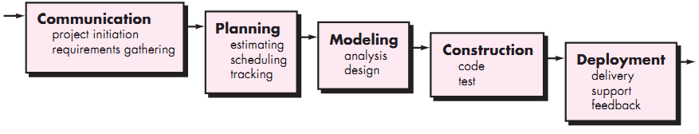
Waterfall model
Slide-3
The waterfall or linear sequential model
Problems of the Waterfall Model
Inflexible partitioning of the project into distinct stages. The next phase starts only after the completion of the previous phase
This makes it difficult to respond to changing customer requirements (no backtracking)
Therefore, this model is only appropriate when the requirements are well-understood
SB

Slide 4
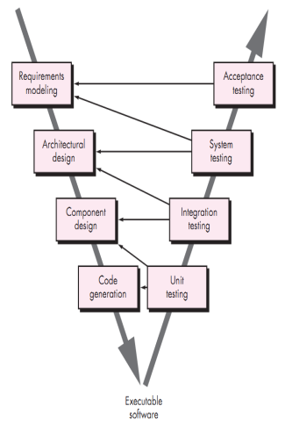
V - model
Slide-4
The V-model is an SDLC model in which process execution happens sequentially in a V-shape. It is also known as a Verification and Validation model.
V-Model is an extension of the waterfall model and is based on an association of a testing phase for each corresponding development stage. This means that every single phase in the development cycle has a directly associated testing phase.
This is a highly disciplined model, and the next phase starts only after the completion of the previous phase.
SB

Slide 5
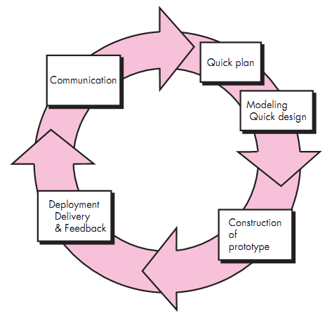
Prototyping model
Slide-5
Requirements are not precise, and the prototype serves as a mechanism for identifying software requirements
Iteration occurs as the prototype is tuned to satisfy the needs of the customer
System requirements ALWAYS evolve during a project, so process iteration is proper where earlier stages are reworked and is always part of the process for large systems
SB

Slide 6
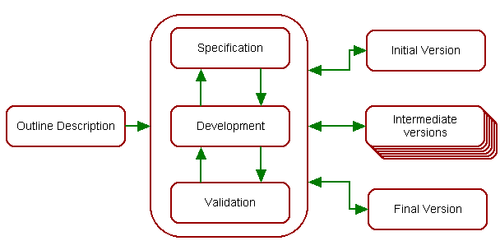
Evolutionary development
Slide-6
Exploratory development: Objective is to work with customers and to evolve a final system from an initial outline specification. Should start with well-understood requirements
Throw-away prototyping: Objective is to understand the system requirements. Should start with poorly understood requirements
SB

Slide 7
Incremental development
Slide-7
Rather than delivering the system as a single delivery, development and delivery are broken down into increments, with each increment delivering part of the required functionality (SPIRAL).
The requirements are relatively certain but there are many complexities that leads to frequent changes.
User requirements are prioritized, and the highest priority requirements are included in early increments
Once the development of an increment is started, the requirements are frozen though requirements for later increments can continue to evolve
Analysis
Design
Code
Test
Delivery
increment #1
Analysis
Design
Code
Test
Delivery
increment #2
Analysis
Design
Code
Test
Delivery #3
Calendar time
SB

Slide 8
Incremental development
Slide-8
Advantages of Incremental Development
Customer value can be delivered with each increment, so system functionality is available earlier
Deliver the core product first
Early increments act as a prototype to help elicit requirements for later increments
Lower risk of overall project failure
The highest priority system services tend to receive the most testing
SB

Slide 9
Rapid Application Development (RAD)
Slide-9
It is a type of incremental model. The developments are time-boxed, delivered, and then assembled into a working prototype
In the RAD model, the components or functions are developed in parallel as if they were mini projects (frozen requirements in each increment)
This can quickly give the customer something to see and use and to provide feedback
Delivers a fully functional system in 90 days, give or take 30 days
Phases of RAD are:
Requirements Planning
User Design (user interacts with the system analysts)
Construction (program and application development)
Cutover (testing, changeover to new system, user training)
SB

Slide 10
Component based development model
Slide-10
Identify
component
Suitable for re-usable object-oriented classes
Apply characteristics of spiral development
Construct
nth inter
system
Lookup
components
in library
Put new
components
in library
Exract
components
if available
Build
components
if unavailable
SB

Slide 11
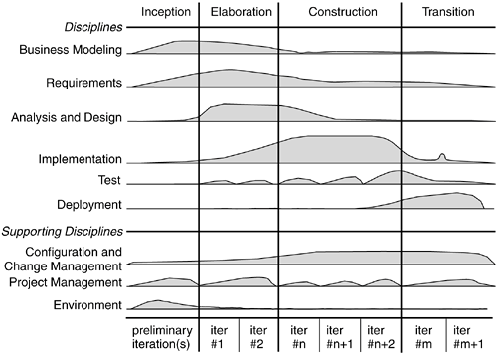
Rational Unified Process (RUP)
Slide-11
SB
Notes:
1. Inception Phase: Define project scope, objectives, and business case. Identify key requirements and risks and create initial plans.
2. Elaboration Phase: Refine requirements and validate system architecture. Mitigate risks and plan the construction phase.
3. Construction Phase: Develop, integrate, and test system components. Ensure functionality and quality through iterative builds.
4. Transition Phase: Deploy the product and train users. Address defects and gather user feedback.

Slide 12
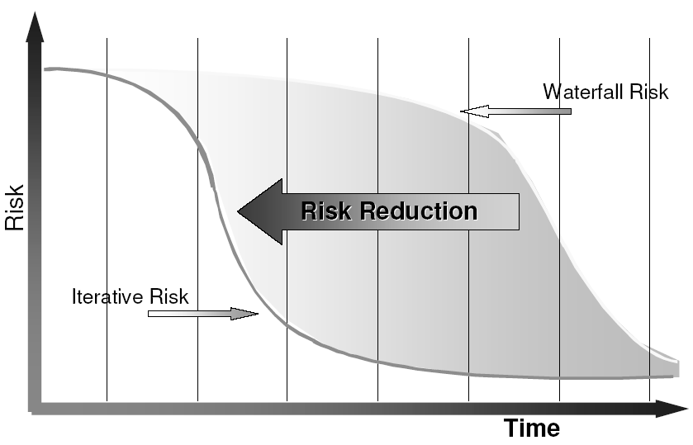
Risk profile
Slide-12
SB

Slide 13
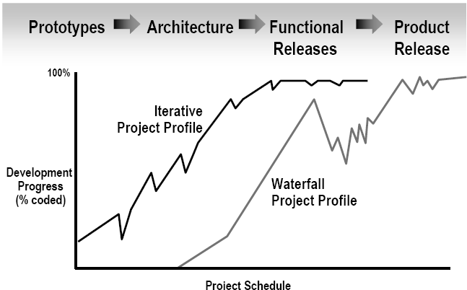
Reduce Scrap/Rework: Use an Iterative Process
Slide-13
Iterative Development
Products are visible at an early stages of development
Low probability of rework in case of defects in the deliverable product
SB

Slide 14
references
Slide - 14
R.S. Pressman & Associates, Inc. (2010). Software Engineering: A Practitioner’s Approach.
Kelly, J. C., Sherif, J. S., & Hops, J. (1992). An analysis of defect densities found during software inspections. Journal of Systems and Software, 17(2), 111-117.
Bhandari, I., Halliday, M. J., Chaar, J., Chillarege, R., Jones, K., Atkinson, J. S., & Yonezawa, M. (1994). In-process improvement through defect data interpretation. IBM Systems Journal, 33(1), 182-214.
SB

